Slide 1
Fast Nielsen-Thurston Classification
Balázs Strenner
Georgia Institute of Technology
joint with Dan Margalit, S. Öykü Yurttaş
Geometry of Teichmüller space and mapping class groups
University of Warwick
April 9-13, 2018

Slide 2
The Nielsen-Thurston Classification
Mod(S)
Finite order
Pseudo-Anosov
Reducible

Slide 3
The Nielsen-Thurston Classification Problem
Fix finite generating set for Mod(S).
OUTPUT
INPUT
Finite order
f = s₁s₂...s_{N}
Algorithm
Reducible
Pseudo-Anosov
+ order,
reducing curves, foliations and stretch factors on pieces
Running time: function of N.

Slide 4
Prior results on Classification
Higher genus surfaces, exponential algorithm: Thurston & Mosher ‘70s-’82, Bestvina-Handel ’95, Hamidi-Tehrani & Chen ’96, Koberda-Mangahas ’13, Bell: NP,co-NP (arXiv ‘16)
Braids, quadratic algorithm: Los ’93, Bernadete-Gutierrez-Nitecki ’95, Calvez ’13

Slide 5
Main Theorem
Theorem (Margalit-S-Yurttaş): Quadratic-time algorithm for the Nielsen-Thurston Classification Problem.
Bell-Webb (arXiv ‘16): Polynomial-time algorithm to determine Nielsen-Thurston type and find: order, reducing curves, and translation length in the curve complex.

Slide 6

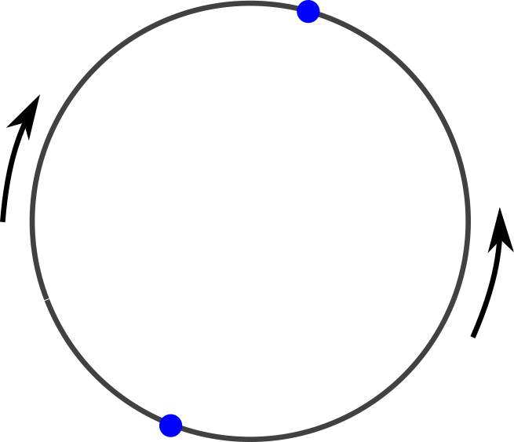
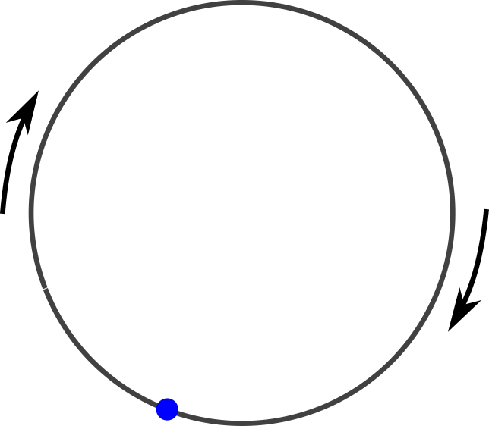
Isometries of
sink
source
source/sink
elliptic
(up to power)
hyperbolic
parabolic

Slide 7
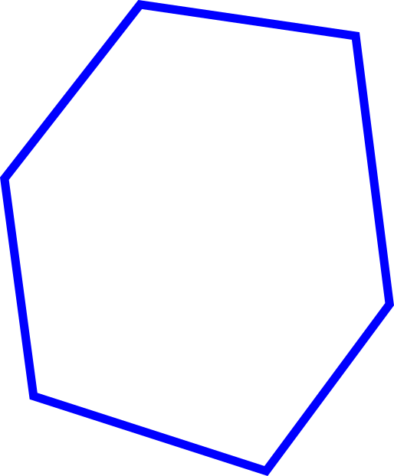
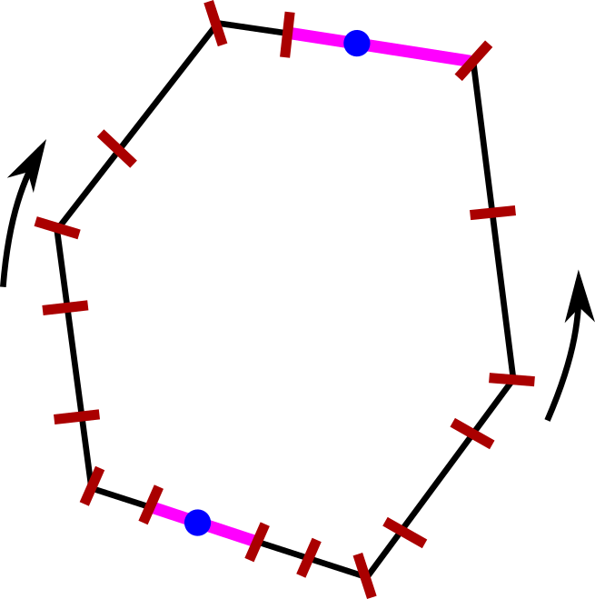
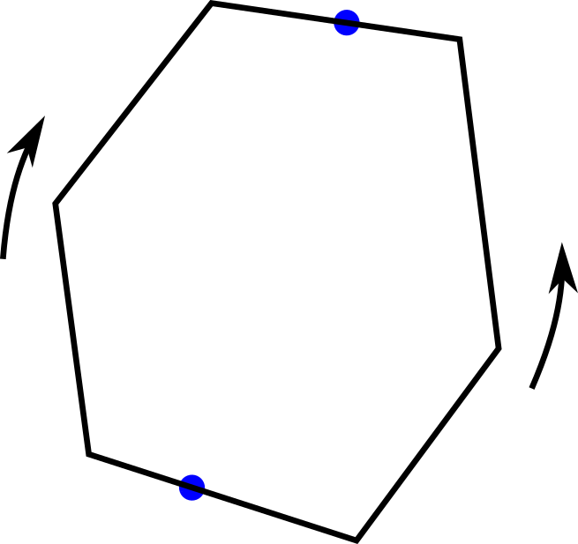
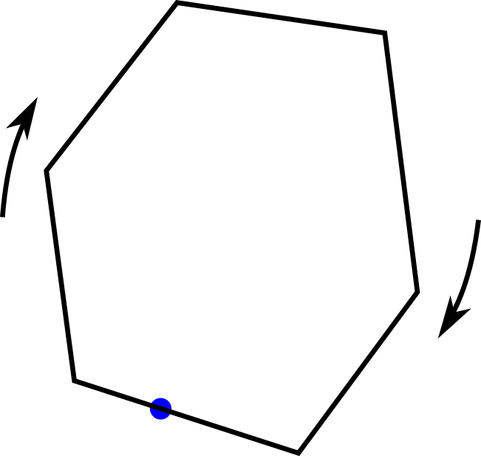
The mapping class group
PMF(S)
sink (F^{u})
Teich(S)
source (F^{s})
source/sink
(invariant curves)
finite order
(up to power)
pseudo-Anosov
Reducible

Slide 8
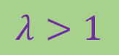
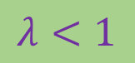
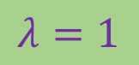
Thurston (70s): Compute the piecewise linear map and find all the eigenvectors.
🙂
Exponentially many pieces
☹️
PMF(S)
sink (F^{u})
$$λ>1$$
Teich(S)
$$λ=1$$
$$λ<1$$
source (F^{s})
source/sink
(invariant curves)
finite order
(up to power)
pseudo-Anosov
Reducible

Slide 9
Iterate!
~2010:
Toby Hall: Dynn, first iterate, then compute eigenvectors.
😀
sink
Unknown rate of convergence
Unknown behavior in reducible case
😩
Bit later:
Margalit-S-Yurttaş: Let’s try to prove that convergence is fast.
✓
source
Bell-Schleimer: Let’s try to prove that convergence is slow.
✓
Bell-Schleimer: convergence can be exponentially slow
☹️😢😭
Margalit-S-Yurttaş: O(1) iterations is enough.
👍🏼
O(1) iterations

Slide 10
Iterate!
sink
Margalit-S-Yurttaş: Let’s try to prove that convergence is fast.
Bell-Schleimer: Let’s try to prove that convergence is slow.
source
Bell-Schleimer (‘15): convergence can be exponentially slow in the linear piece.
Margalit-S-Yurttaş (‘15): We get into the attracting linear piece in O(N) iterations.
☹️😢😭
Margalit-S-Yurttaş: O(1) iterations is enough.
👍🏼
O(1) iterations

Slide 11
Algorithm v1

Slide 12
Linear charts on MF = train tracks
MF = measured foliations
Train track

Slide 13
Linear charts on MF = train tracks
Measured train track

Slide 14
Linear charts on MF = train tracks

Slide 15
Linear charts on MF = train tracks
measured foliation

Slide 16
Algorithm – setup
1. Fix a cell decomposition of PMF.
2. Fix some c in PMF.
c
Standard train tracks

Slide 17
Algorithm v1 (cubic)
Check if finite order.
Compute f^{Q}(c) for some Q = O(N).
Compute the acting matrix at f^{Q}(c).
Compute eigenvalues and eigenvectors.
Check if the eigenvecors correspond to reducing curves, filling or non-filling pA foliations.
f^{Q}(c)
c

Slide 18
Cubic time
Thm (MSY): We get into the attracting linear piece in O(N) iterations.

Slide 19
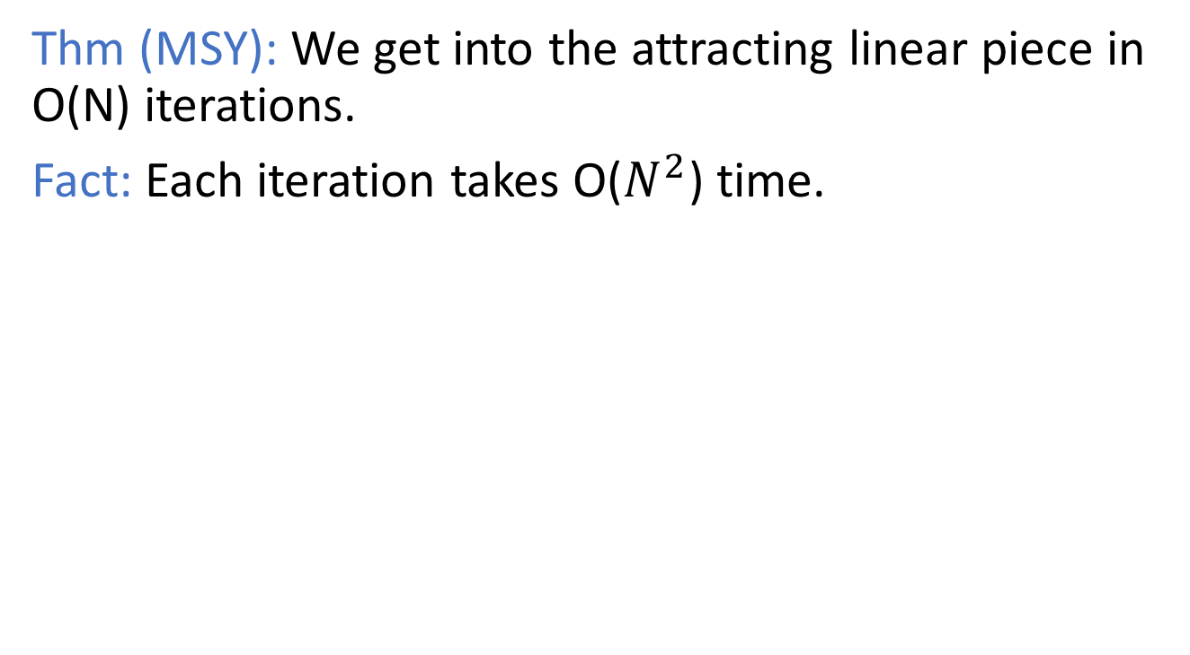
Cubic time
Thm (MSY): We get into the attracting linear piece in O(N) iterations.
Fact: Each iteration takes O($N^{2}$) time.

Slide 20
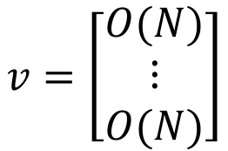
Cubic time
Thm (MSY): We get into the attracting linear piece in O(N) iterations.
Fact: Each iteration takes O($N^{2}$) time.
point in PMF
$$v=\left[\begin{matrix}O(N) \\ ⋮ \\ O(N)\end{matrix}\right]$$

Slide 21
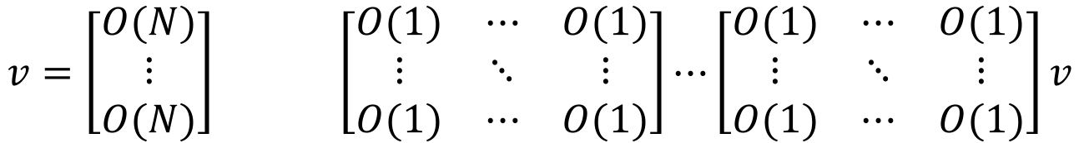
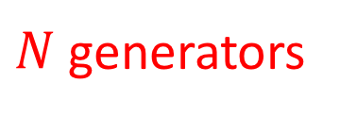
Cubic time
Thm (MSY): We get into the attracting linear piece in O(N) iterations.
Fact: Each iteration takes O($N^{2}$) time.
point in PMF
image of point
$$v=\left[\begin{matrix}O(N) \\ ⋮ \\ O(N)\end{matrix}\right] \left[\begin{matrix}O(1) & ⋯ & O(1) \\ ⋮ & ⋱ & ⋮ \\ O(1) & ⋯ & O(1)\end{matrix}\right]⋯\left[\begin{matrix}O(1) & ⋯ & O(1) \\ ⋮ & ⋱ & ⋮ \\ O(1) & ⋯ & O(1)\end{matrix}\right]v$$
$N$ generators

Slide 22
Why do we get into the attracting linear piece in O(N) iterations?

Slide 23
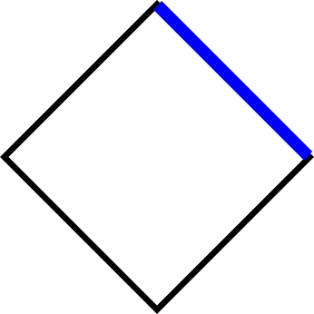
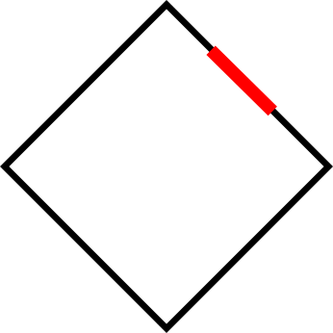
Linearly compatibity = carrying
Attracting linear piece: Invariant train track carried by a standard train track.

Slide 24
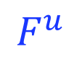
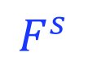
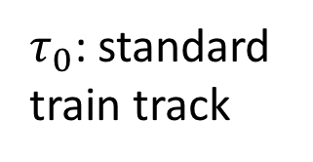
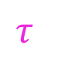
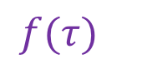
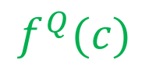
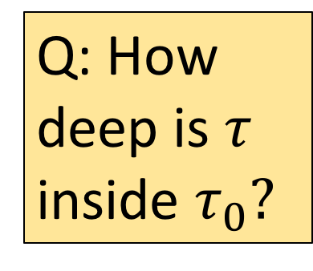
f^{Q}(x)
Attracting linear piece
$$F^{u}$$
$${f(τ)}_{}$$
$$f^{Q}(c)$$
$$τ_{}$$
Carried curves
c
$τ_{0}$: standard train track
f
Q: How deep is $τ$ inside $τ_{0}?$
c: starting curve
$$F^{s}$$
Curve complex

Slide 25
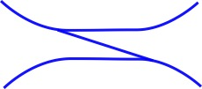
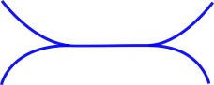
Splittings
A way to create train tracks carried.
split
split

Slide 26
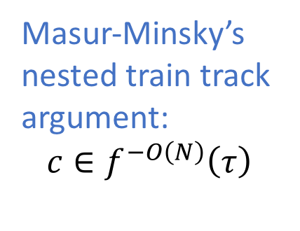
Agol (‘11): maximal splitting sequence
$$F^{u}$$
$${f(τ)}_{}$$
Bell (‘14): preperiodic length is at most O(N) times the periodic length
$$τ_{}$$
Masur-Minsky’s nested train track argument:
$$c∈f^{−O\left(N\right)}\left(τ\right)$$
$τ_{0}$: standard train track
f
c: starting curve

Slide 27
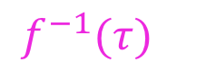
Agol (‘11): maximal splitting sequence
$${f^{−1}(τ)}_{}$$
$$F^{u}$$
$${f(τ)}_{}$$
Bell (‘14): preperiodic length is at most O(N) times the periodic length
Masur-Minsky’s nested train track argument:
$$c∈f^{−O\left(N\right)}\left(τ\right)$$
$τ_{0}$: standard train track
f
c: starting curve

Slide 28
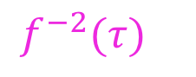
Agol (‘11): maximal splitting sequence
$${f^{−2}(τ)}_{}$$
$$F^{u}$$
$${f(τ)}_{}$$
Bell (‘14): preperiodic length is at most O(N) times the periodic length
Masur-Minsky’s nested train track argument:
$$c∈f^{−O\left(N\right)}\left(τ\right)$$
$τ_{0}$: standard train track
f
c: starting curve

Slide 29
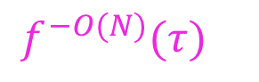
Agol (‘11): maximal splitting sequence
$$F^{u}$$
$${f(τ)}_{}$$
Bell (‘14): preperiodic length is at most O(N) times the periodic length
$${f^{−O(N)}(τ)}_{}$$
Masur-Minsky’s nested train track argument:
$$c∈f^{−O\left(N\right)}\left(τ\right)$$
$τ_{0}$: standard train track
c: starting curve

Slide 30
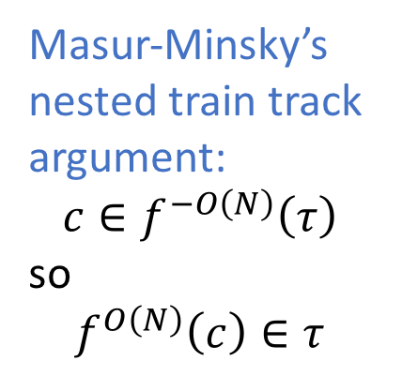
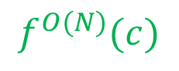
Agol (‘11): maximal splitting sequence
$$F^{u}$$
$${f(τ)}_{}$$
Bell (‘14): preperiodic length is at most O(N) times the periodic length
$$f^{O(N)}(c)$$
$$τ_{}$$
Masur-Minsky’s nested train track argument:
$$c∈f^{−O\left(N\right)}\left(τ\right)$$
so
$$f^{O\left(N\right)}\left(c\right)∈τ$$
$τ_{0}$: standard train track
c: starting curve

Slide 31
Main tool in reducible case
Masur-Mosher-Schleimer (‘12): splitting sequences and progress made in subsurfaces.

Slide 32
Subtlety 1
Computing the eigenvalues quickly is problematic because of Bell-Schleimer. Iterative methods are all exponential.
Solution: Use Newton’s method to find the largest eigenvalue quickly.

Slide 33
Subtlety 2
For a reducible with multiple pseudo-Anosov components, how do we find all pA stretch factors, not just the largest one?

Slide 34
Subtlety 2
For a reducible with multiple pseudo-Anosov components, how do we find all pA stretch factors, not just the largest one?
Solution: Factor the characteristic polynomial to irreducible factors

Slide 35
Subtlety 2
For a reducible with multiple pseudo-Anosov components, how do we find all pA stretch factors, not just the largest one?
Solution: Factor the characteristic polynomial to irreducible factors (cubic time by Lenstra-Lenstra-Lovász’s seminal 1982 work on lattice reductions).

Slide 36
Subtlety 2
For a reducible with multiple pseudo-Anosov components, how do we find all pA stretch factors, not just the largest one?
Solution: Factor the characteristic polynomial to irreducible factors (cubic time by Lenstra-Lenstra-Lovász’s seminal 1982 work on lattice reductions). Then run Newton’s method on each factor to find the largest root.

Slide 37
😢
The bound for the number of iterations is only O(N), but we think O(1) should be possible as well.

Slide 38
Algorithm v2

Slide 39
Old tools
Agol (‘11)
Bell (‘14)
Masur-Mosher-Schleimer (‘12)
New tools
Flat surfaces
Slope
Veering triangulations (Agol, Guéritaud, Minsky-Taylor)

Slide 40
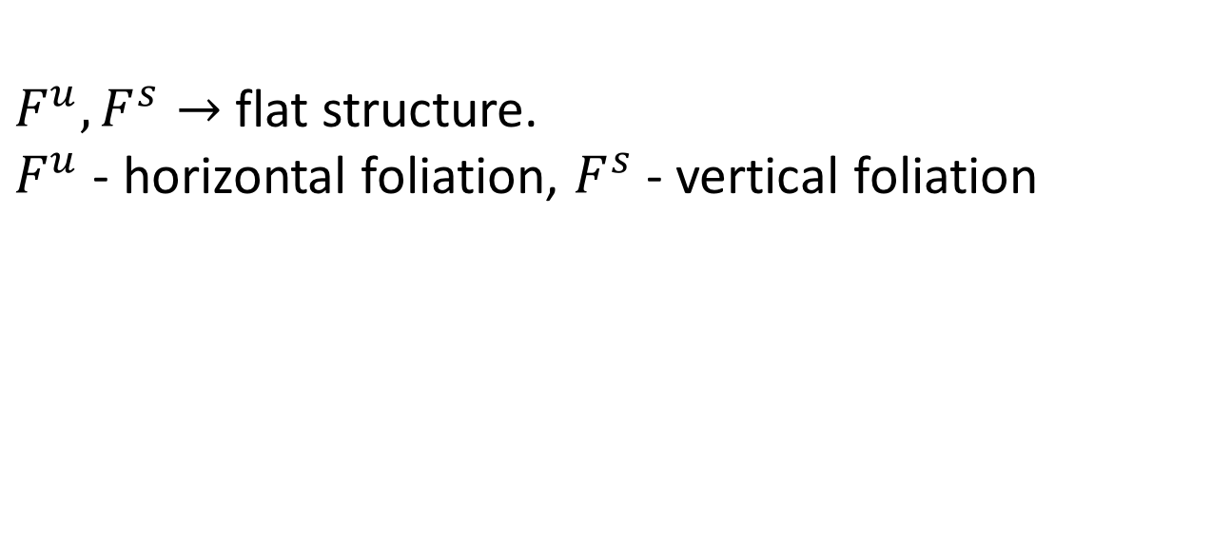
Slope
$F^{u}, F^{s}→$ flat structure.
$F^{u}$ - horizontal foliation, $F^{s}$ - vertical foliation

Slide 41
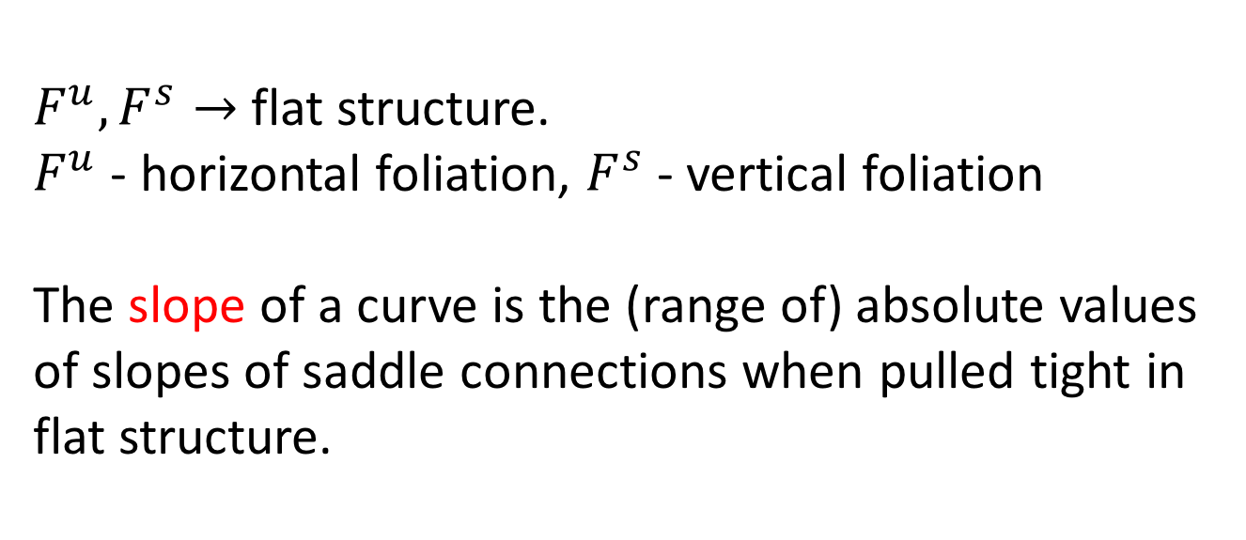

Slope
$F^{u}, F^{s}→$ flat structure.
$F^{u}$ - horizontal foliation, $F^{s}$ - vertical foliation
The slope of a curve is the (range of) absolute values of slopes of saddle connections when pulled tight in flat structure.
0
$$∞$$

Slide 42
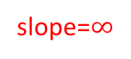
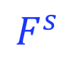
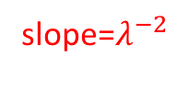
slope=$λ^{−2}$
slope=1
slope=0
$$F^{u}$$
$${f(τ)}_{}$$
$$f^{Q}(c)$$
$$τ_{}$$
$τ_{0}$: standard train track
f
c: starting curve
$$F^{s}$$
slope=$∞$

Slide 43
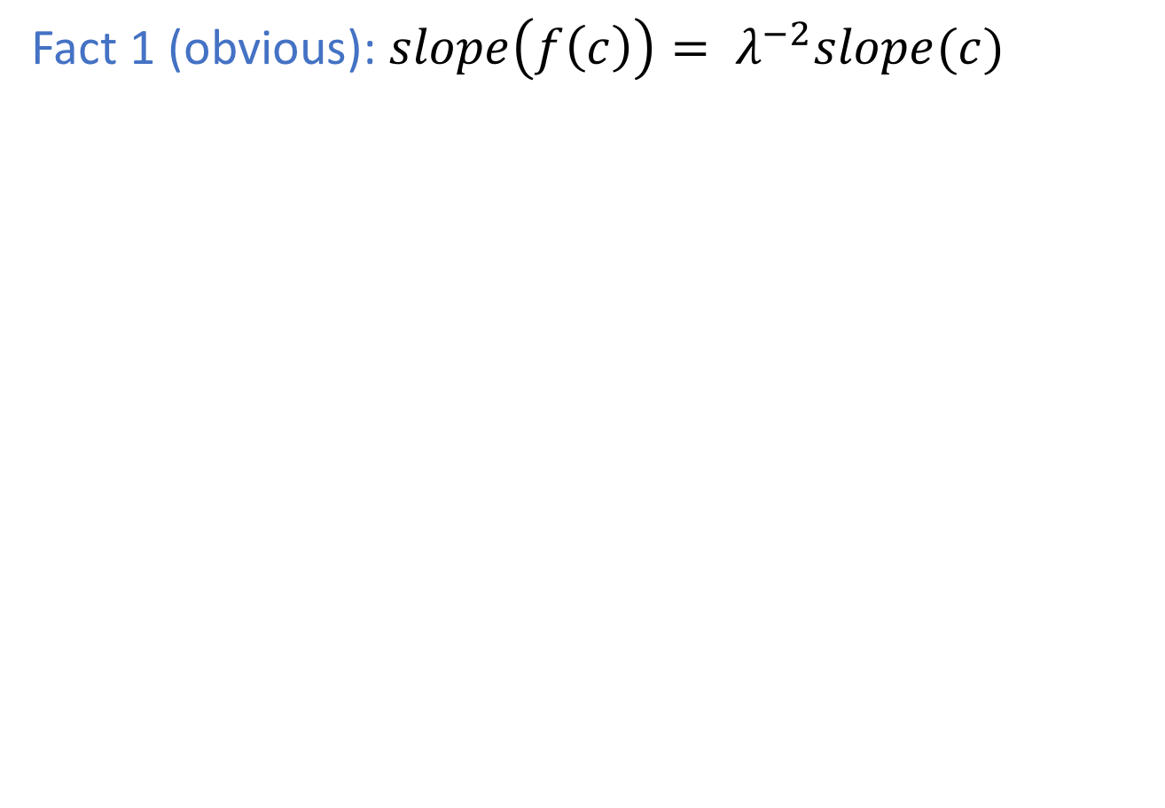
Fact 1 (obvious): $slope\left(f\left(c\right)\right)= λ^{−2}slope(c)$

Slide 44
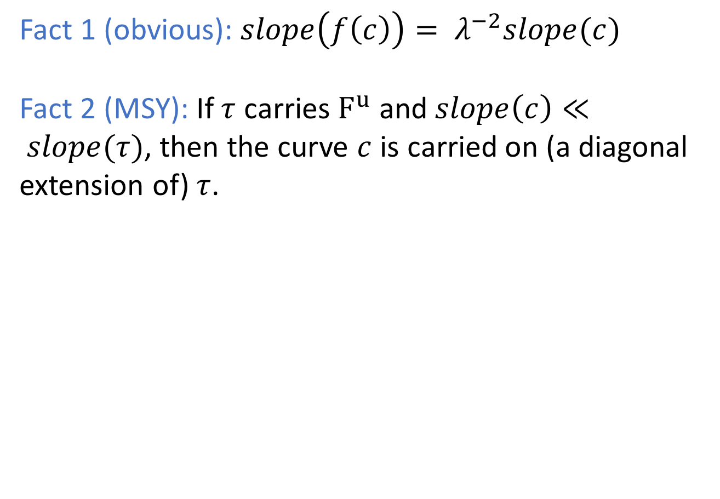
Fact 1 (obvious): $slope\left(f\left(c\right)\right)= λ^{−2}slope(c)$
Fact 2 (MSY): If $τ$ carries $F^{u}$ and$slope\left(c\right)≪ slope(τ)$, then the curve $c$ is carried on (a diagonal extension of) $τ$.

Slide 45
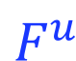
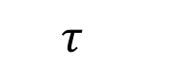
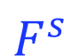
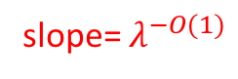
Fact 1 (obvious): $slope\left(f\left(c\right)\right)= λ^{−2}slope(c)$
Fact 2 (MSY): If $τ$ carries $F^{u}$ and$slope\left(c\right)≪ slope(τ)$, then the curve $c$ is carried on (a diagonal extension of) $τ$.
$$F^{u}$$
slope= $λ^{−O(1)}$
slope=1
$$τ_{}$$
$$F^{s}$$

Slide 46
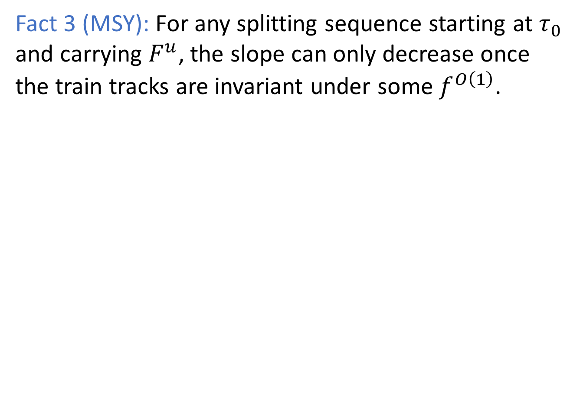
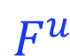
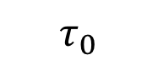

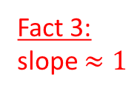
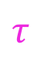
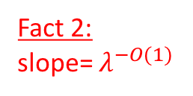
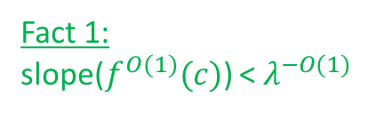
Fact 3 (MSY): For any splitting sequence starting at $τ_{0}$ and carrying $F^{u}$, the slope can only decrease once the train tracks are invariant under some $f^{O\left(1\right)}$.
Fact 2:
slope= $λ^{−O(1)}$
$$F^{u}$$
Fact 1:
slope($f^{O(1)}(c)$) < $λ^{−O(1)}$
$$τ_{}$$
slope=1
Fact 3:
slope $≈1$
no change in slope here
$$τ_{0}$$
$$F^{s}$$
c: starting curve

Slide 47
Issue
Lenstra-Lenstra-Lovász’s cubic time polynomial factorization does not cut it anymore.
Solution: van Hoeij-Novocin’s quadratic time improvement (‘12).

Slide 48
Issue
Trouble with more than 1-dimensional eigenspaces. E.g., it is possible that 1 is an eigenvalue with high multiplicity, but there is only one reducing curve.
Solution: Use train track splittings to identify the portion of the eigenspace that stays positive under splittings.

Slide 49
Algorithm v2 (quadratic)
Check if finite order.
Compute f^{Q}(c) for some Q = O(1).
Compute the acting matrix at f^{Q}(c).
Compute eigenvalues and eigenvectors.
Check if the eigenvecors correspond to reducing curves, filling or non-filling pA foliations.
f^{Q}(c)
c

Slide 50
There must be a better way
😞

Slide 51
There must be a better way
We shouldn’t have to rely on deep results from computational number theory.

Slide 52
There must be a better way
We shouldn’t have to rely on deep results from computational number theory.
Dealing with the eigenspaces this way is quite technical and annoying.
Realization:

Slide 53
There must be a better way
We shouldn’t have to rely on deep results from computational number theory.
Dealing with the eigenspaces this way is quite technical and annoying.
Realization: It is a mistake to resort to linear algebra. By doing that, we lose geometric information that we need to recover later by other methods.

Slide 54
PMF
&
Linear algebra
Train tracks

Slide 55
Algorithm v3

Slide 56
Goals
f^{Q}(c)
c

Slide 57
Goals
Find the train track of the attracting linear region.
f^{Q}(c)
c

Slide 58
Goals
Find the train track of the attracting linear region.
Compute the train track self-map instead of just the matrix.
f^{Q}(c)
c

Slide 59
Natural splitting sequences

Slide 60
Natural splitting sequences

Slide 61
Natural splitting sequences

Slide 62
Natural splitting sequences

Slide 63
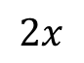
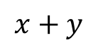



Natural splitting sequences
$$y≥x$$
$$2x$$
$$x+y$$
$$2y$$
$$x+y$$

Slide 64
Natural splitting sequences
$$y≥x$$
$$2x$$
$$x+y$$
$$2y$$
$$x+y$$

Slide 65
Natural splitting sequences
$$y≥x$$
$$2x$$
$$x+y$$
$$2y$$
$$x+y$$

Slide 66
Natural splitting sequences
$$y≥x$$
$$2x$$
$$x+y$$
$$2y$$
$$x+y$$

Slide 67
Natural splitting sequences
$$y≥x$$
$$2x$$
$$x+y$$
$$2y$$
$$x+y$$

Slide 68
Natural splitting sequences
$$y≥x$$
$$2x$$
$$x+y$$
$$2y$$
$$x+y$$

Slide 69
Natural splitting sequences
$$y≥x$$
$$2x$$
$$x+y$$
$$2y$$
$$x+y$$

Slide 70
Natural splitting sequences
$$y≥x$$
$$2x$$
$$x+y$$
$$2y$$
$$x+y$$

Slide 71
Natural splitting sequences
$$y≥x$$
$$2x$$
$$x+y$$
$$2y$$
$$x+y$$

Slide 72
Natural splitting sequences

Slide 73

Natural splitting sequences
$$y≤x$$
$$2x$$
$$x+y$$
$$2y$$
$$x+y$$

Slide 74
Natural splitting sequences
$$y≤x$$
$$2x$$
$$x+y$$
$$2y$$
$$x+y$$

Slide 75
Natural splitting sequences
$$y≤x$$
$$2x$$
$$x+y$$
$$2y$$
$$x+y$$

Slide 76
Natural splitting sequences
$$y≤x$$
$$2x$$
$$x+y$$
$$2y$$
$$x+y$$

Slide 77
Natural splitting sequences
$$y≤x$$
$$2x$$
$$x+y$$
$$2y$$
$$x+y$$

Slide 78
Natural splitting sequences
$$y≤x$$
$$2x$$
$$x+y$$
$$2y$$
$$x+y$$

Slide 79
Natural splitting sequences

Slide 80
Natural splitting sequences

Slide 81
Natural splitting sequences

Slide 82

“Natural” splitting sequences associated to f:
Apply the generators after each other and perform just as many splittings as necessary to be carried on a standard train track.
We get: $τ_{0}→⋯→τ_{n}$ such that ${f(τ}_{n})$ is carried by a standard train track.
Fact: n = O(N).
Problem: There are many such splitting sequences. Which one should we compute?

Slide 83
We want this linear piece
f^{Q}(c)
c

Slide 84

We want this linear piece
f^{Q}(c)
So we should always split such that $F^{u}$ is carried.
c

Slide 85
We want this linear piece
f^{Q}(c)
So we should always split such that $F^{u}$ is carried.
c
Problem: We don’t know what $F^{u}$ is.

Slide 86

We want this linear piece
f^{Q}(c)
So we should always split such that $F^{u}$ is carried.
c
Problem: We don’t know what $F^{u}$ is.
Solution: Split towards ${f^{Q}(c)}^{}$instead.

Slide 87

We want this linear piece
f^{Q}(c)
So we should always split such that $F^{u}$ is carried.
c
Problem: We don’t know what $F^{u}$ is.
Solution: Split towards ${f^{Q}(c)}^{}$instead.
We get: $τ_{0}→⋯→τ_{n}$ such that ${f(τ}_{n})$ is carried by a standard train track and ${f^{Q}(c)}^{}$is carried on $τ_{n}$.

Slide 88





Natural splitting sequence towards $f^{Q}(c)$.
$$F^{u}$$
length=O(N)
$${f(τ_{n})}_{}$$
Problem: this $τ_{n}$ may not be invariant.
$$τ_{n}$$
$$f^{Q}(c)$$
length=O(N)
$$F^{s}$$
$τ_{0}$: standard train track
c: starting curve

Slide 89

Natural splitting sequence towards $f^{Q}(c)$.
$$F^{u}$$
$${f(τ_{n})}_{}$$
Problem: this $τ_{n}$ may not be invariant.
Cause: oversplitting.
$$τ_{n}$$
$$f^{Q}(c)$$
$$F^{s}$$
$τ_{0}$: standard train track
c: starting curve

Slide 90



Natural splitting sequence towards $f^{Q}(c)$.
$$F^{u}$$
$${f(τ_{n})}_{}$$
Problem: this $τ_{n}$ may not be invariant.
Cause: oversplitting.
Solution: fold $τ_{n}$ until “possible”.
$$f(τ^{′})$$
$$τ_{n}$$
$$f^{Q}(c)$$
$$τ′$$
$$F^{s}$$
$τ_{0}$: standard train track
c: starting curve

Slide 91

We have:
$τ^{′}$ carried on $τ_{0}$
${f(τ}^{′})$ carried on $τ_{0}$
we cannot fold $τ^{′}$ anymore
$$F^{u}$$
$$f(τ^{′})$$
$$τ′$$
$$F^{s}$$
$τ_{0}$: standard train track

Slide 92

We have:
$τ^{′}$ carried on $τ_{0}$
${f(τ}^{′})$ carried on $τ_{0}$
we cannot fold $τ^{′}$ anymore
$$F^{u}$$
$$f(τ^{′})$$
Morally true
proposition:
If $f$ is pA, then ${f(τ}^{′})$ is carried on $τ^{′}.$ In other words, $τ^{′}$ is an invariant train track.
$$τ′$$
$$F^{s}$$
$τ_{0}$: standard train track

Slide 93

We have:
$τ^{′}$ carried on $τ_{0}$
${f(τ}^{′})$ carried on $τ_{0}$
we cannot fold $τ^{′}$ anymore
$$F^{u}$$
$$f(τ^{′})$$
Morally true
proposition:
If $f$ is pA, then ${f(τ}^{′})$ is carried on $τ^{′}.$ In other words, $τ^{′}$ is an invariant train track.
If $f$ is reducible, then the twisting reducible curves and invariant train tracks for partial pseudo-Anosovs appear as subtracks of $τ^{′}$.
$$τ′$$
$$F^{s}$$
$τ_{0}$: standard train track

Slide 94

$$F^{u}$$
We still need to compute how ${f(τ}^{′})$ is carried on $τ^{′}.$
$$f(τ^{′})$$
$$τ′$$
$$F^{s}$$
$τ_{0}$: standard train track

Slide 95

$$F^{u}$$
We still need to compute how ${f(τ}^{′})$ is carried on $τ^{′}.$
$$f(τ^{′})$$
Solution:
Split $τ_{0}$ towards $τ^{′}$ and update how $f\left(τ^{′}\right)$ is carried.
$$τ′$$
$$F^{s}$$
$τ_{0}$: standard train track

Slide 96
$$F^{u}$$
We still need to compute how ${f(τ}^{′})$ is carried on $τ^{′}.$
$$f(τ^{′})$$
Solution:
Split $τ_{0}$ towards $τ^{′}$ and update how $f\left(τ^{′}\right)$ is carried.
$$τ′$$
$$F^{s}$$
$τ_{0}$: standard train track

Slide 97
$$F^{u}$$
We still need to compute how ${f(τ}^{′})$ is carried on $τ^{′}.$
$$f(τ^{′})$$
Solution:
Split $τ_{0}$ towards $τ^{′}$ and update how $f\left(τ^{′}\right)$ is carried.
$$τ′$$
$$F^{s}$$
$τ_{0}$: standard train track

Slide 98
$$F^{u}$$
We still need to compute how ${f(τ}^{′})$ is carried on $τ^{′}.$
$$f(τ^{′})$$
Solution:
Split $τ_{0}$ towards $τ^{′}$ and update how $f\left(τ^{′}\right)$ is carried.
$$τ′$$
$$F^{s}$$
$τ_{0}$: standard train track

Slide 99
$$F^{u}$$
We still need to compute how ${f(τ}^{′})$ is carried on $τ^{′}.$
$$f(τ^{′})$$
Solution:
Split $τ_{0}$ towards $τ^{′}$ and update how $f\left(τ^{′}\right)$ is carried.
$$τ′$$
$$F^{s}$$
$τ_{0}$: standard train track

Slide 100
Improvements over v2
A natural, more geometric way to obtain the reducing curve, invariant train tracks.
No dependence on polynomial factorization algorithms.
Better bounds on the length of the splitting sequence.
No PMF, just train tracks. More hope to adapt to Out(F_{n}).

Slide 101
Main ingredients
Characterizations (using slope) for a train track carrying a curve or another train track.
Efficient representation of a train track carrying another train track.
Show that various operations (splitting/folding the carrying/carried track) can be performed efficiently.
Work out how those ”natural” splittings work on closed surfaces with pants decomposition markings.

Slide 102

Macaw (implementation)

Slide 103

REU 2017 (Georgia Tech)
Ian Katz
Yandi Wu
Yihan Zhou

Slide 104



Goal: works for closed surfaces
Punctured surfaces
Closed surfaces
a
3
a
3
3
b
3
b
e
4
e’
2
c
d
c
d
3
1
3
1
Penner (’82)
e’ = max(a+c,b+d)-e

Slide 105




Slide 107


Train tracks under change of marking
Punctured surfaces
Closed surfaces
2
2
split
4
4
2
4
4
2
2
fold
Possibilities:
$$4∙4=16$$
Possibilities:
$$4∙4∙2^{5}=512$$

Slide 108


Slide 109




1. Works for closed surfaces
2. Solves the word problem/checks relations
3. Computes the order
2. Approximates stretch factors

Slide 110
Thank you!

